Slide 1

Dr Toolbox:
Enabling Trainees to Support Each Other
Dr Will Barker, MBBS, MRCGP

Slide 2

Why Dr Toolbox
“It’s 0930 on Day 2 into working here and I’m stressed…
The SpR is in clinic and I need to book an endoscopy for an upper GI bleed, a Contrast CT, refer to the respiratory team and get a critical care review…
I can’t remember any of this from induction!”
Notes:
So let me begin with a real life scenario.
Who do you go about asking how to get these things done. Everybody seems to think its done a different way, you feel like you are wasting the time of the seniors asking how to get inane things done. And then when you realise you need the form, you don’t know where the form is kept, and in all likelihood it won’t tell you what number you need to send it off to. This sort of knowledge, if you are anything like the F1’s at my trust takes up a considerable part of your day, and certainly had nothing to do with the knowledge you spent years filling up your brain at med school

Slide 3
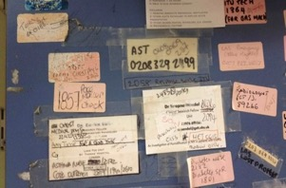
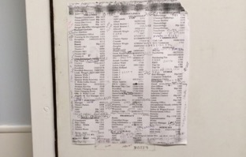
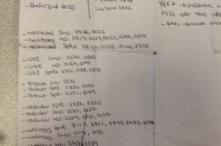
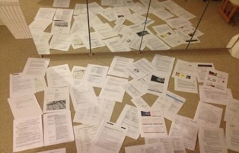
Is this the best we can do in 2020?

Slide 4

A Common Problem for Junior Doctors
Junior Doctors rotate to new trusts frequently
Changeover is stressful, induction is brief and there is loss of intrinsic ‘local’ knowledge between rotating doctors
Much time is wasted spent finding out how to do common tasks rather than actually doing the tasks themselves
  Requesting many different tests
  Making referrals to many different specialities
  Using hospital guidelines that are difficult to find
This wasted time removes genuine learning opportunities, makes the job tedious and can affect patient safety

Slide 5
Dr Toolbox: Enhancing junior doctors' working lives
Dr Toolbox is:
Your portable, paperless local induction
Easily updated & can form part of a Doctor’s own QUIP
Simple to create for new trusts
Better than your hospital intranet
Dr Toolbox includes:
How to make referrals & request tests
Information about rotations and on-call duties
Bleeps and extension numbers with direct dial function
Dr Toolbox can be extended to include:
Local reference guides and protocols
www.dr-toolbox.com

Slide 6
Dr Toolbox: Fulfilling your CQC requirements
SAFE:
Dr Toolbox gives Healthcare Professionals the safer
induction that they deserve
Improves handover at the end of the year
EFFECTIVE:
Dr Toolbox ensures staff have local knowledge to deliver
effective care
WELL LED:
Dr Toolbox places a strong emphasis on the safety and
well being of staff
Provides an avenue for QI and encourages
continuous learning, improvement and innovation
www.dr-toolbox.com

Slide 7
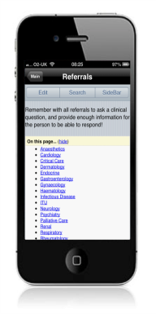
So what is Dr Toolbox?
Notes:
So here’s a demo
It’s the wikipedia on how to get stuff done in the NHS
For junior doctors it’s a portable, paperless induction tool
For the trust, the GMC and CQC, its about providing a safer induction for doctors and passing on that improved safety to patients
In brief the Toolbox is a website, similar to Wikipedia type format that we provide as a template for junior doctors to set up at their trusts.
It’s password protected and contains all the useful information specific to junior doctors. If you want to know the bleep

Slide 8
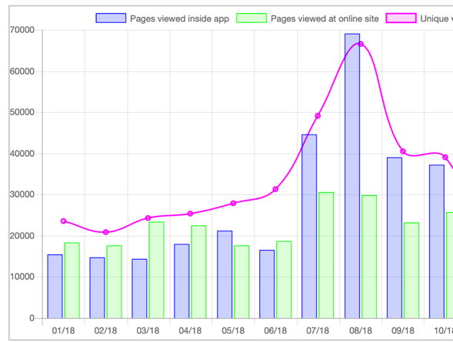
Usage spike when starting at new hospitals

Slide 9
Secrets of a successful site
A Toolbox Champion: a senior clinician or manager. They are an advocate for the project, provide overall governance and ensure continuity when Lead Editors change
Lead Editors: Content added by enthusiastic editors
Access: A link from the hospital intranet to the site and desktop icon on the hospital computers
Handover: the site must be shared with the new intake of trainees in July and August, and new Lead Editors allocated

Slide 10
Dr Toolbox supported service
We have recently created a major overhaul of or website and app and are moving beyond the free unsupported version of Dr Toolbox we have done in the past to a new version with back end support.
This pays for the software updates, data backups, and general support that is expected with digital innovations in the NHS.
As well as making the website and app sustainable in the long term it also pays for continual innovation and support for the Lead Editors and Dr Toolbox Champion
Notes:
Indeed we have been advised by the NHS and Digital Health London that to be able to continue our work we need to generate revenue to sustain Dr Toolbox in the long term.

Slide 11
Dr Toolbox supported service
Website & Mobile phone app (Android, Apple, HTML5)
Unlimited users
Unlimited pages
Daily backups of information
Certificates for lead editors
Support with technical issues

Slide 12
What we would expect from you
Allocate Dr Toolbox Champion, Lead Editors, and a Local Administrator
The Champion and Lead Editors collate and upload the local information
The site is publicized in July and August and included in the local Foundation Programme induction
New editors are allocated in August

Slide 13
What you can expect from us
Website & Mobile phone app (Android, Apple, HTML5). Support with Unlimited users. Unlimited pages
Daily backups of information
Certificates for lead editors
Support with technical issues
Peer support for lead editors, pairing up with other leading hospitals
Feedback on site usage and statistics and reminders

Slide 14
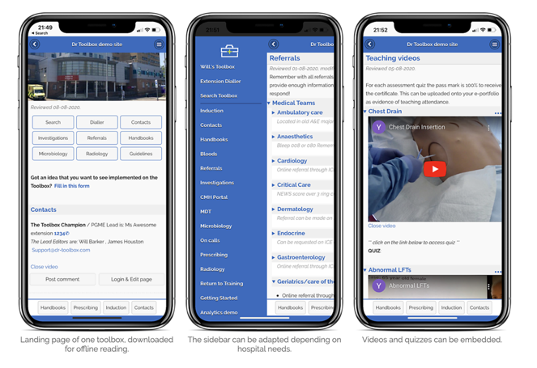
Dr Toolbox: Your portable and paperless induction
https://www.dr-toolbox.com/Main/DrToolboxVideos

Slide 15


Slide 16

Thanks!
dr-toolbox.com
james@dr-toolbox.com
will@dr-toolbox.com

